Slide 1
HAsim
Michael Adler Joel Emer Elliott Fleming Michael Pellauer Angshuman Parashar

Slide 2
Architectural Modeling: A New Way of Using FPGAs
Functional Emulator
Functionally equivalent to target, but does not provide any insights on design metrics
Prototype (or Structural Emulator)
Logically isomorphic and functionally equivalent representation of a design
Model
Sufficiently logically and functionally equivalent to allow estimation of design metrics of interest, e.g., performance, power or reliability

Slide 3
HAsim is More than a Single Model
Asim (software) is layered on OS and libraries
FPGA provides no OS/library services
HAsim is the combination of:
LEAP (Logic-based Environment for Application Programming) platform
Functional model
Timing model
Other projects are using LEAP
H.264 decoder
WiFi implementation

Slide 4
HAsim Components for Building Models
Split Timing / Functional Model
Functional Model
Primarily homed on FPGA [ISPASS 2008]
Hybrid hardware / software for infrequent operations [WARP 2008]
Timing Model
Maintain model time [ISFPGA 2008]
Multiplexing to save FPGA area [Submitted to HPCA]
Platform
Un-model services (start/stop, statistics, events…)
OS / library services [In preparation ISFPGA 2011]
Always-present virtual devices
Base set of physical devices
Configuration Tools
Easy transition between physical platforms [Submitted to ISFPT]
Reusable components [MOBS 2007, WARP 2010, ANCS 2010]
Soft connections [DAC 2009]

Slide 5
Simulation Physical Platform
FPGA Modules
Software Modules
Fetch
Decode
Execute
Decode
Controller
Func Model
Controller
Stub
Stub
Stub
Stub
Stub
Stub
Stub
Stub
SID 0
SID 1
SID 0
SID 1
SID 0
SID 1
SID 0
SID 1
Server
Manager
Client
Manager
Server
Manager
Client
Manager
Channel 0
Channel 1
Channel 1
Channel 0
Virtual Channel Mux
Virtual Channel Mux
Physical Channel
Physical Channel
Bluesim Simulation
UNIX Pipe Interface

Slide 6
PCIe-based Physical Platform
FPGA Modules
Software Modules
Fetch
Decode
Execute
Decode
Controller
Func Model
Controller
Stub
Stub
Stub
Stub
Stub
Stub
Stub
Stub
SID 0
SID 1
SID 0
SID 1
SID 0
SID 1
SID 0
SID 1
Server
Manager
Client
Manager
Server
Manager
Client
Manager
Channel 0
Channel 1
Channel 1
Channel 0
Virtual Channel Mux
Virtual Channel Mux
Virtual Channel Mux
Virtual Channel Mux
Physical Channel
Physical Channel
CSR
DMA
Interrupt
CSR
Interrupt
PCIe HwChannels Driver
PCIe Kernel Driver

Slide 7
FSB-based Physical Platform
FPGA Modules
Software Modules
Fetch
Decode
Execute
Decode
Controller
Func Model
Controller
Stub
Stub
Stub
Stub
Stub
Stub
Stub
Stub
SID 0
SID 1
SID 0
SID 1
SID 0
SID 1
SID 0
SID 1
Server
Manager
Client
Manager
Server
Manager
Client
Manager
Channel 0
Channel 1
Channel 1
Channel 0
Virtual Channel Mux
Virtual Channel Mux
Virtual Channel Mux
Virtual Channel Mux
Physical Channel
Physical Channel
CSR
DMA
Interrupt
CSR
Interrupt
FSB HwChannels Driver
FSB Kernel Driver

Slide 8
Configuration using AWB (Architect’s Workbench)
Common code with Asim
Design broken into modules with specific interfaces
A design is a hierarchical composition of modules
Modules with the same interface can be substituted using a plug-and-play GUI
Build environment automatically constructed from specification

Slide 9
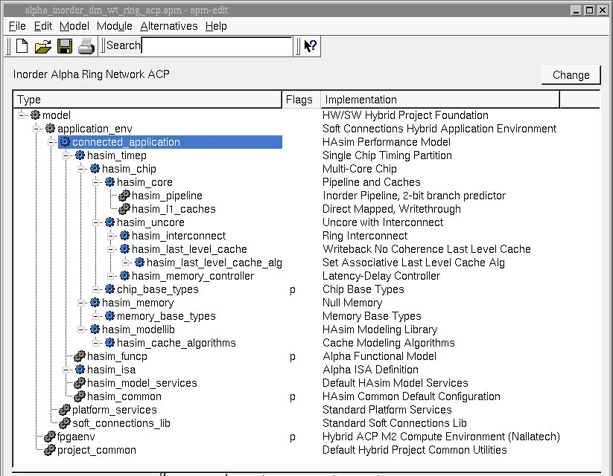
HAsim Timing Model Top Level Configuration

Slide 10
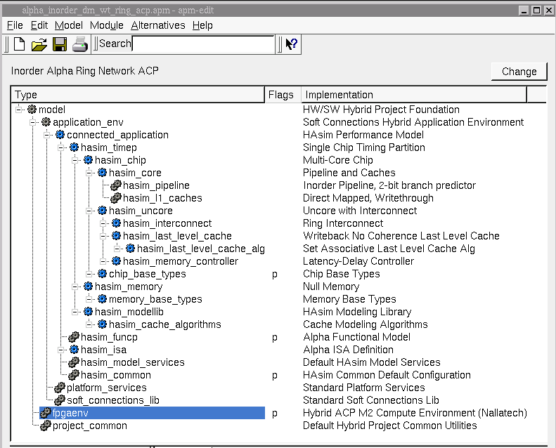
ACP (Front Side Bus)

Slide 11
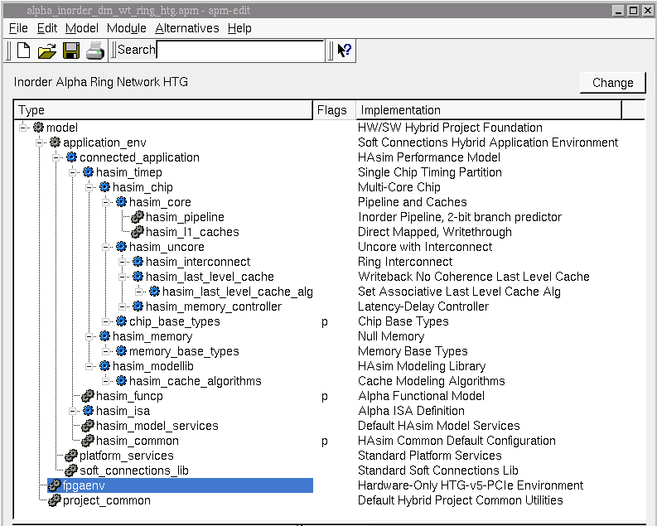
PCIe Interface

Slide 12
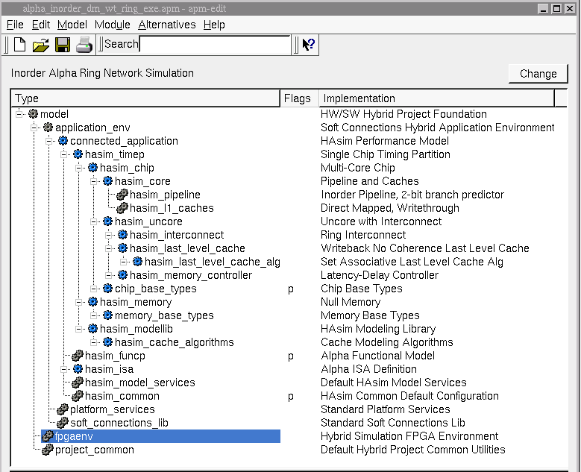
BlueSim (Software Simulation)

Slide 13
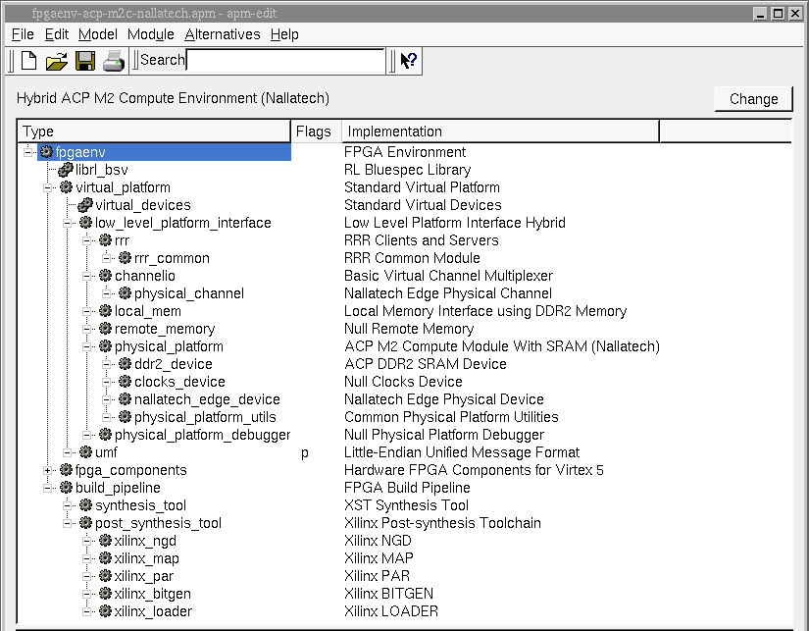
FPGA Environment

Slide 14
Memory Scratchpads
_{Model}
…
_{Client}
…
_{BRAM}

Slide 15
Memory Scratchpads
_{Model}
…
_{Client}
…
_{Marshaller}
_{Functional} _{Memory}
…
FPGA Memory Interfaces
_{Private} _{Cache}
…
…
_{Platform}
_{Scratchpad} _{Device}
_{Central} _{Cache}
_{Local} _{Memory}
_{Host}
_{Host} _{Scratchpad}

Slide 16
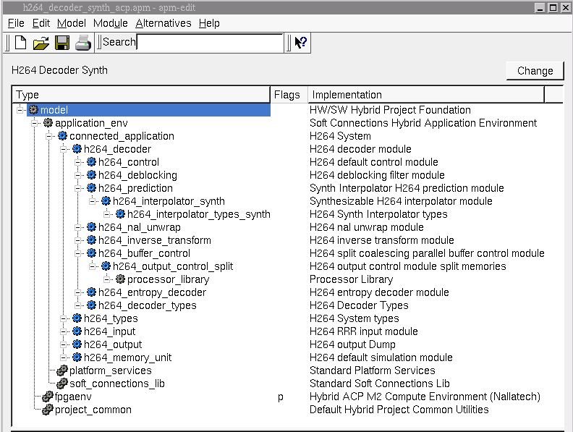
H.264

Slide 17
But We Wanted to Build a Timing Model
FPGAs have limited capacity
Not all circuits map well into LUTs
Solution: Configure FPGA into a model of the design
FPGA cycle != model cycle [RAMP Retreat 2005]
Use FPGA-optimal structures when modeling FPGA-poor structures
Offload rare but complex algorithms to software

Slide 18
Example: Register File Target
Register File with 2 Read Ports, 2 Write Ports
Reads take zero clock cycles in target
Direct configuration onto V2 FPGA: 9242 slices, 104 MHz
 | CC 1 | CC 2
rd_addr1 | A | C
rd_val1 | V(A) | V(C)
rd_addr2 | B | D
rd_val2 | V(B) | V(D)

Slide 19
Separating Model Clock from FPGA Clock
Simulate the circuit using BlockRAM
First do reads, then serialize writes
Only update model time when all requests are serviced
Results: 94 slices, 1 BlockRAM, 224 MHz
Simulation rate is 224 / 3 = 75 MHz (FPGA-to-Model Ratio)
 | Model CC 1
FPGA CC: | 1 | 2 | 3
rd_addr1 | A | A | A
rd_val1 |  | V(A) | V(A)
rd_addr2 | B | B | B
rd_val2 |  |  | V(B)

Slide 20

Example: 256-KB Cache
Model a cache with a Scratchpad
Scratchpad size = cache size
Scratchpad private cache may hit or miss
Orthogonal to target cache hits or misses
Affects simulation rate, not results
How do we connect our cache model to our register file model?
How do we efficiently compose many such modules into a working simulator?
Backing
Memory
(64 GB)
HOST
Cache
Controller
Scratchpad
Memory
(256 KB)
Private
Cache
(BRAM, 1 KB)
Shared
Cache
(S/DRAM,
8 MB)

Slide 21
Time in Software Asim
FET
DEC
1
EXE
MEM
WB
1
1
1
1
Software has no inherent clock
Model time is tracked via Asim “Ports”
Modules computation consumes no time
Ports have a static model time latency for messages
All communication goes through ports
Execution model: for each module in system
Check input ports for messages, update local state, write output ports
Can use as the basis for controller-free simulation on FPGA
Each module can compute at any wall clock rate
2

Slide 22
A-Port Network on FPGA
Minimum buffer size: latency + 1
Initialize each port with initial messages equal to latency
Modules may proceed in “dataflow” manner:
Stall until all incoming ports contain a message (or NoMessage)
Dequeue all inputs, compute, update local state
Write all output ports once (may write NoMessage)
Effect: adjacent modules may be simulating different cycles

Slide 23
Flow Control Using A-Ports
A
B
1
1
Compose credit protocol using multiple A-Ports

Slide 24
Example: Inorder Front End
1
Legend: Ready to simulate?
redirect
No
Yes
Part
training
1
(from Back End)
Line
Pred
(from Back End)
Branch
Pred
1
2
fault
vaddr
pred
1
0
1
mispred
inst
or
fault
0
first
FET
ITLB
IMEM
PC
Resolve
Inst
Q
FET
IMEM
0
1
1
1
0
vaddr
paddr
enq
or
drop
0
deq
paddr
0
0
rspImm
I$
1
rspDel
1
slot
Notes:
NB: CONTAINS ANIMATION
Slide Goals:
Establish how A-Ports compose into a system using an animation.
Main Points:
Initially we place timing tokens equal to port latency on each edge.
This results in some modules able to simulate target CC 1. These modules are yellow, like Fetch and PC Resolve.
A module is ready to simulate when all incoming ports have a timing token (and implicitly the outgoing port buffering must not be full).
Other modules can not simulate because they do not have timing tokens on every incoming edge, such as the Line Predictor or InstQ.
(First Click)
Now each module consumes one incoming token, does work, and writes all outgoing ports.
Note that this results in a different set of modules able to simulate. For instance, the ITLB cannot simulate model cycle 2 until Fetch has finished model cycle 1.
If we were to continue this animation we would eventually re-enable every module and simulation would continue infinitely.
(Second Click)
So now that we have this scheme as a baseline for one core, how can we extend to multicore simulation.
Other Relevant Points:
Fetch and IMem are examples of phased-execution. Fetch cannot finish the first target cycle until it gets a line predictor response.
In reality the modules take different numbers of FPGA cycles to simulate. This animation doesn’t show this, but does give an idea of why the scheme tolerates it.

Slide 25
Simulation Target: Shared Memory CMP with OCN
Core 0
Core 1
Core 2
r
r
r
r
msg
msg
Memory
Control
credit
r
credit
OCN router
Possible approach: Duplicate cores
Benefits:
Simple to describe
Maximum parallelism
Drawbacks:
Probably won’t fit
Low utilization of functional units (~13%)
Notes:
Slide Goals:
* Explain the duplication approach and justify why it is not our choice.
Main Points:
The simplest way to simulate a multicore is just to duplicate the modules for each core.
Such a scheme is easy to describe since you just instantiate the modules multiple times.
Also you get the best possible parallelism since you always have a functional unit to do any possible work.
One drawback is low utilization – we’re not eliminating the gray boxes from the animation.
The real drawback is the area overhead – it’s just too big without going to multiple boards.

Slide 26
Possible Approach #2
Duplicate Ports, Time-Multiplex Modules
Local module state is duplicated, mux’d
Benefits:
Better unit utilization
Drawbacks:
More expensive than duplication(!)
Notes:
Slide Goals:
Express the port duplication approach and convey its unexpected problem.
Main Points:
The next approach we examined was duplicating the ports while multiplexing the modules.
In this scheme the execution semantics is “wait until all the incoming ports of a particular CPU are not-empty.”
In this scheme each module could be simulating a different CPU from adjacent modules.
To our surprise, this scheme ended up consuming more area than straight duplication. We surmise that this was due to the multiplexors, as well as the logic to decide which context to do next. It could also be that place-and-route in the duplicated scheme was easier.
The area makes this scheme a non-starter for us.

Slide 27
Our Current Approach
Round-Robin Time-Division Multiplexing
Single port with more buffering
Benefits:
Much better area
Good unit utilization
Drawbacks:
Head-of-line blocking may limit performance
Notes:
Slide Goal:
Convey the multiplexed scheme, and why we selected it.
Main Points:
In this scheme the ports themselves are time-multiplexed.
Each port is a single queue. At any time this queue can contain timing tokens from multiple CPUs, analogous to SMT in a processor.
Local state is still duplicated and multiplexed.
Simulation order now goes round-robin across the CPUs.
Therefore head-of-line blocking can become an issue, as a slow yellow token will hold up the green and blue tokens behind it.
The extent that head-of-line blocking can be a problem is currently under investigation.

Slide 28
The Front End Multiplexed
1
Legend: Ready to simulate?
redirect
No
CPU
1
CPU
2
training
1
(from Back End)
Line
Pred
(from Back End)
Branch
Pred
1
2
fault
vaddr
pred
1
0
1
mispred
inst
or
fault
0
first
FET
ITLB
IMEM
PC
Resolve
Inst
Q
FET
IMEM
0
1
1
1
0
vaddr
paddr
enq
or
drop
0
deq
paddr
0
0
rspImm
I$
1
rspDel
1
slot
Notes:
NB: Contains animation!
Slide Goals:
Convey how the time-multiplexed scheme makes better use of functional units
Main Points:
The only difference between the original picture and this is that the initialization conditions have changed (and the modules have duplicated their local state).
(First Click)
The initial step is the same: the yellow modules read their input ports, do work, and write their output ports.
But now we have no grey modules – everything can either simulate CPU number 1 or 2.
Other Relevant Points:
* If we properly implement Fetch and IMem as internally pipelined, then they can end up simultaneously simulating the various phases of the first clock cycle across different CPUS.

Slide 29
Problem: On-Chip Network
??????????????
r
r
r
r
Previous scheme works because there’s no interaction between virtual cores
Key question: How do we extend multiplexing scheme to OCN?
Notes:
Slide Goal:
Convey the multiplexed scheme, and why we selected it.
Main Points:
In this scheme the ports themselves are time-multiplexed.
Each port is a single queue. At any time this queue can contain timing tokens from multiple CPUs, analogous to SMT in a processor.
Local state is still duplicated and multiplexed.
Simulation order now goes round-robin across the CPUs.
Therefore head-of-line blocking can become an issue, as a slow yellow token will hold up the green and blue tokens behind it.
The extent that head-of-line blocking can be a problem is currently under investigation.

Slide 30
OCN Multiplexing
Simple Example: 2 Routers
1
Router
0
Router
1
1
But order is wrong
Yellow is talking to itself!
Where do these go?
1
1
Mux’d
Router
Mux’d
Router
Mux’d
Router
Permutation
1
Who drives this?
Scales efficiently to grid/torus
Generalizes to arbitrary topologies

Slide 31
Example Model
High-detail, in-order, 9-stage core
Branch predictor, address translation
Up to 16 outstanding memory requests per core
Lockup-free direct-mapped I and D caches
4-way set-associative L2 cache
Grid network of 16 multiplexed cores
Fits on a Vertex 5 LX330

Slide 32
Accomplishments
Robust platform
Platform used for FPGA-based designs at MIT and SNU (Korea)
General performance modeling infrastructure
In-use by multiple architecture groups within Intel
Future
More complicated network topologies
Scale to 1000’s of cores

